Slide 1
Lab 11: Numerical Differentiation (Chapter 21)
BME 313L: Introduction to Numerical Methods in Biomedical Engineering
Spring, 2017

Slide 2
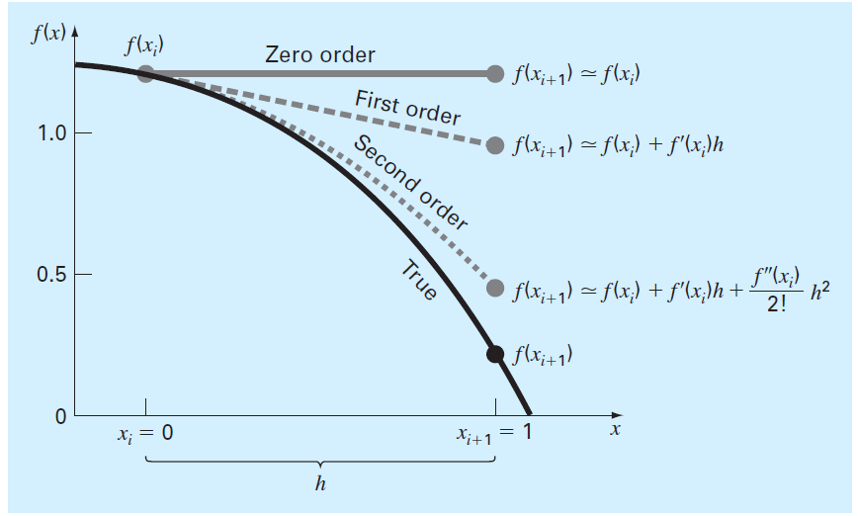
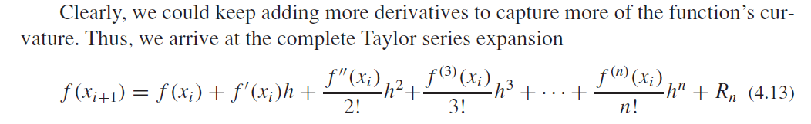

Slide 3
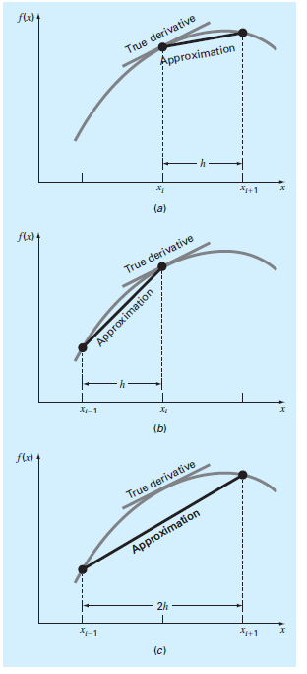
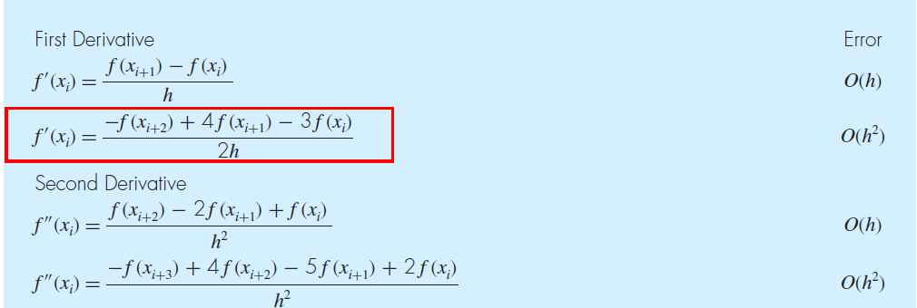
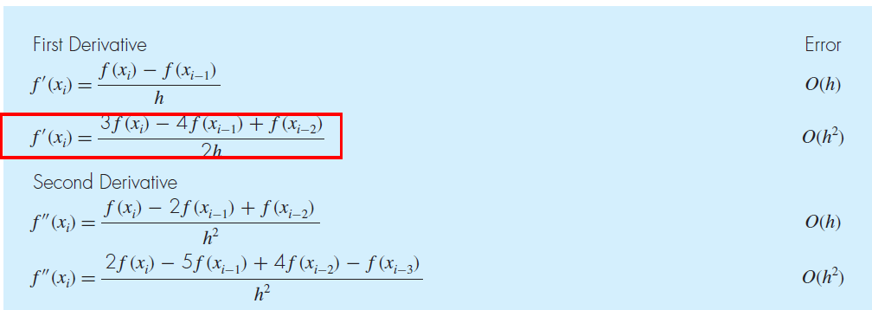
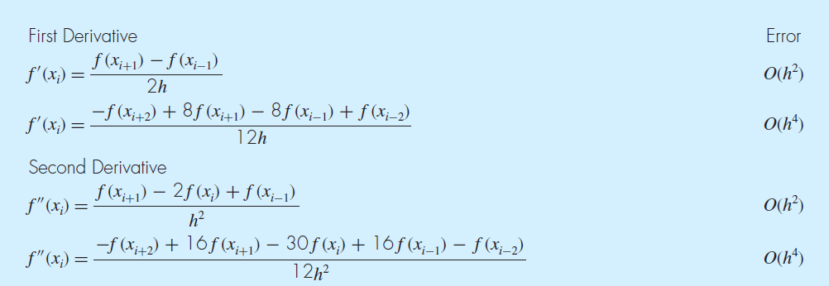
Forward finite-difference formulas
Backward finite-difference formulas
Centered finite-difference formulas

Slide 4
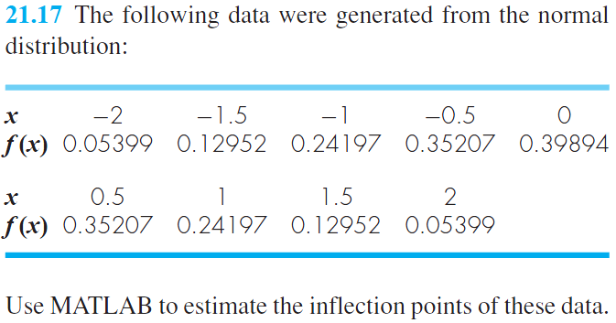
x=[-2 -1.5 -1 -0.5 0 0.5 1 1.5 2];
y=[0.05399 0.12952 0.24197 0.35207 0.39894 0.35207 0.24197 0.12952 0.05399];
a = diff(y) % 8(=9-1) components came out.
b = diff(x)

Slide 5
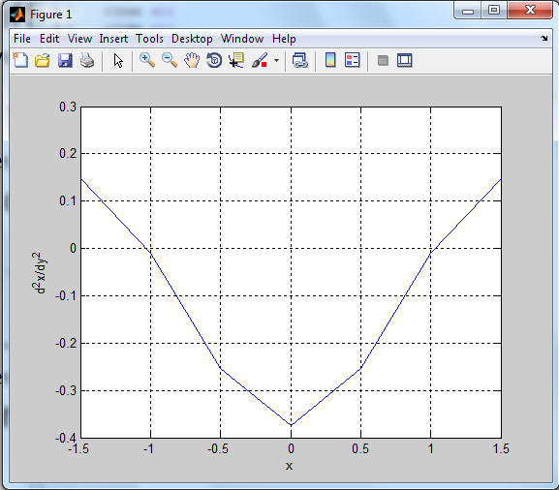
d=diff(y)./diff(x);
% d contains derivative estimates corresponding to the midpoint between adjacent elements.
x=-1.75:.5:1.75;
%Generate new x values for the midpoints
d2=diff(d)./diff(x);
% Second derivative
% d contains derivative estimates corresponding to the midpoint between adjacent elements.
x=-1.5:.5:1.5;
%Generate new x values for the midpoints
plot(x,d2);grid

Slide 6
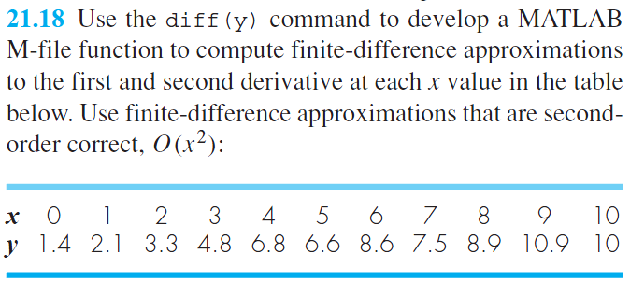

Slide 7
clc
clear all
close all
dx=1.;
y=[1.4 2.1 3.3 4.8 6.8 6.6 8.6 7.5 8.9 10.9 10];
dyf=diff(y); % First Derivative Centered FD using diff
n=length(y);
for i=1:n-2
dydxc(i)=(dyf(i+1)+dyf(i))/(2*dx); % dydx = ( f(i+1)-f(i) + f(i)-f(i-1) ) / (2*dx)
end
%Second Derivative Centered FD using diff
dy2dx2c=diff(dyf)/(dx*dx); % dydx = ( f(i+1)-f(i) – ( f(i)-f(i-1) ) ) / (dx*dx)
fprintf('first derivative \n'); fprintf('%f\n', dydxc)
fprintf('second derivative \n'); fprintf('%f\n', dy2dx2c)

Slide 8
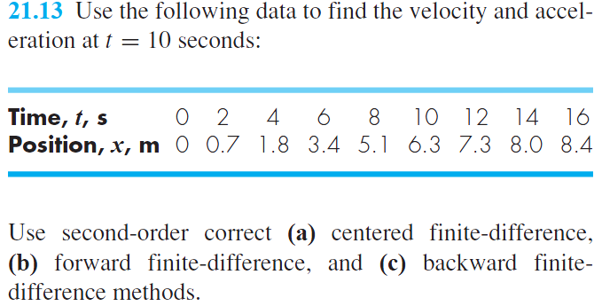
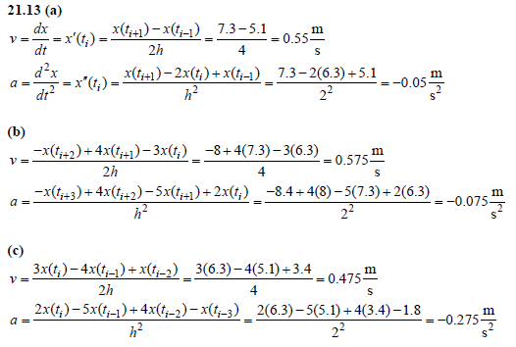
O(h²)
O(h⁴)

Slide 9
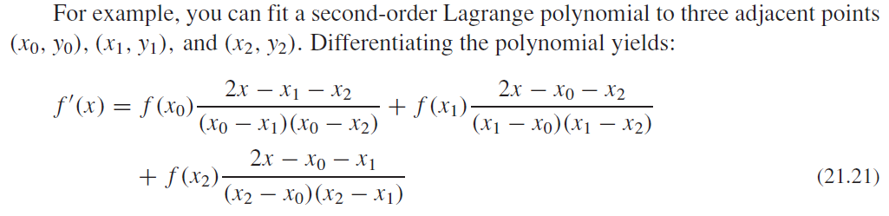
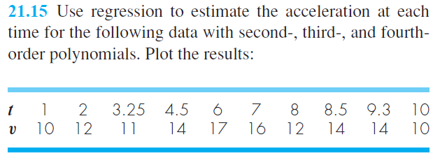
DERIVATIVES OF UNEQUALLY SPACED DATA

Slide 10
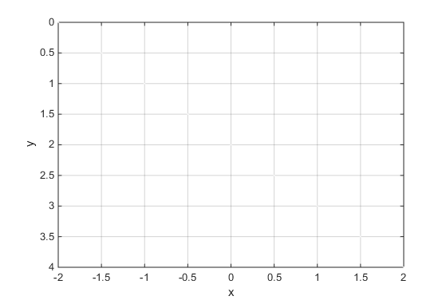
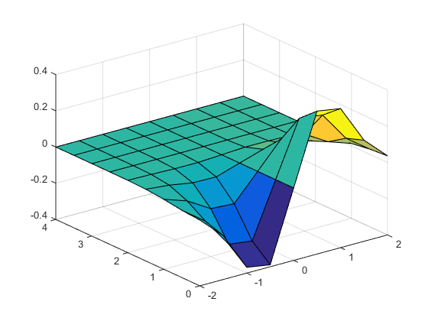
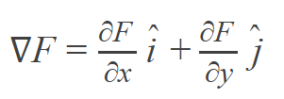
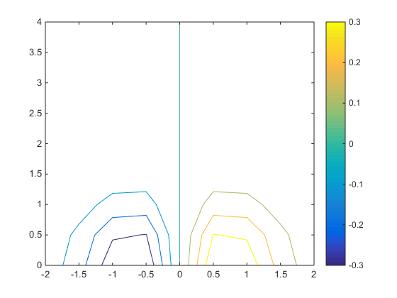
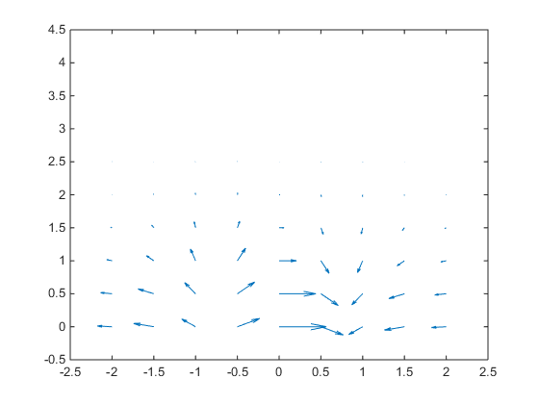
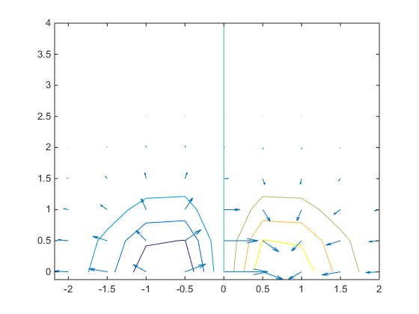
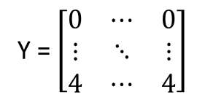
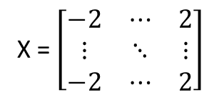
% VISUALIZING FIELDS
x = -2:0.5:2;
y = 0:0.5:4;
[X,Y] = meshgrid(x, y);
Z = X .* exp(-X.^2 - Y.^2)
surf(X,Y,Z)
contour(X,Y,Z)
[pX,pY] = gradient(Z,0.5,0.5)
quiver(X,Y,pX,pY)
X = $\left[\begin{matrix}−2 & ⋯ & 2 \\ ⋮ & ⋱ & ⋮ \\ −2 & ⋯ & 2\end{matrix}\right]$
(x, y) = (-1.5, 3.5)
Y = $\left[\begin{matrix}0 & ⋯ & 0 \\ ⋮ & ⋱ & ⋮ \\ 4 & ⋯ & 4\end{matrix}\right]$
surf
contour
quiver
Contour+quiver

Slide 11
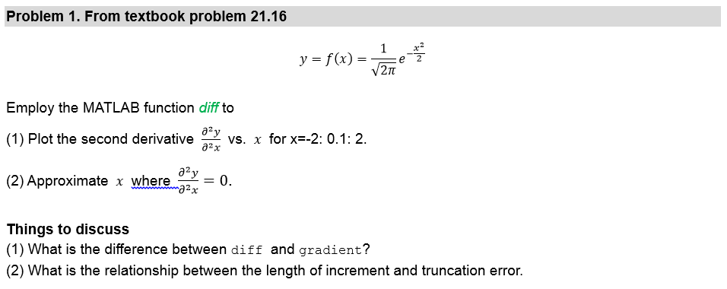

Slide 12
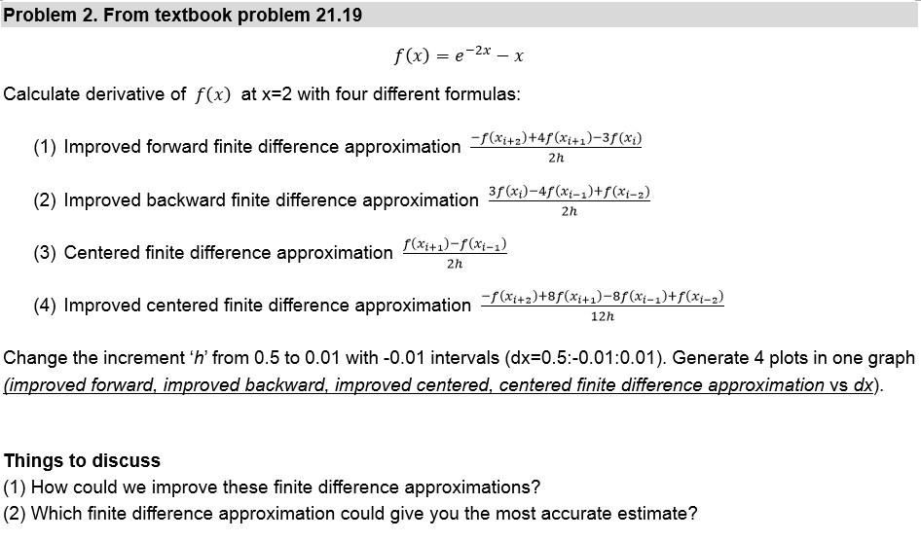

Slide 13
